Slide 1
Basic electronics for embedded SW engineers
Automotive product
By I.Ivanov Sep,2015
iivanov@visteon.com

Slide 2
Agenda
Basic circuits and theory of electric signals
Electronic components & Electrical machines
Microcontrollers and microprocessors
Interfaces & Peripheral devices
Practical Exercises
Page 2

Slide 3
Basic circuits and theory of electric signals
Part one
Electricity
Voltage
A force or pressure must be present before water will flow through a pipeline. Similarly,
electrons flow through a conductor because a force called electromotive force (EMF) is
exerted. The unit of measure for EMF is the volt. The symbol for voltage is the letter U(E in the US literature). A voltmeter is used to measure voltage.
Current
For electrons to move in a particular direction, it is necessary for a potential difference to exist
between two points of the EMF source. The continuous movement of electrons past a given
point is known as current.
It is measured in amperes. The symbol for current is the letter I and for amperes, the letter A.
Resistance
The movement of electrons along a conductor meets with some opposition. This opposition is known as resistance. Resistance can be useful in electrical work. Resistance makes it possible to generate heat, control current flow, and supply the correct voltage to a device.

Slide 4
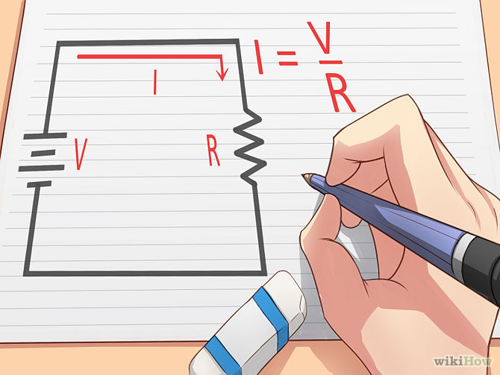
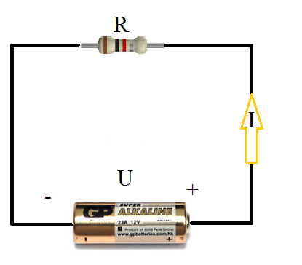
Basic circuits and theory of electric signals
Voltage, resistance and current - Ohm's law
For many conductors of electricity, the electric current which will flow through them is directly proportional to the voltage applied to them.
The ratio of voltage to current is called the resistance, and if the ratio is constant over a wide range of voltages, the material is said to be an "ohmic" material. If the material can be characterized by such a resistance, then the current can be predicted from the relationship:
© Image courtesy of WikiHow

Slide 5
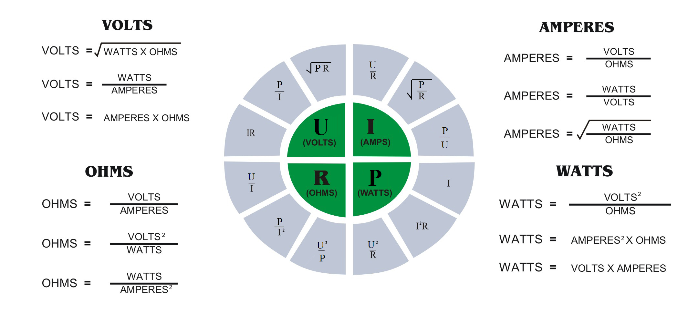
Basic circuits and theory of electric signals
Voltage, resistance and current – Electrical units
© Image courtesy of lomacorelectric.co.za/

Slide 6
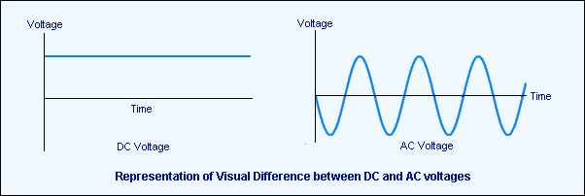
Basic circuits and theory of electric signals
Voltage, resistance and current – Direct Current & Alternating Current
© Image is property of Jivan Khatry/hesston.edu

Slide 7
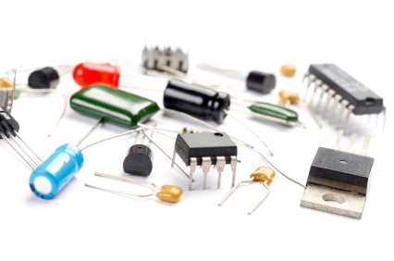
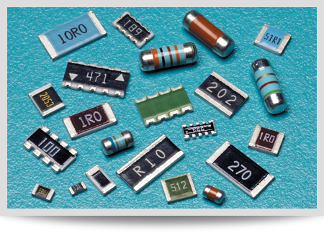
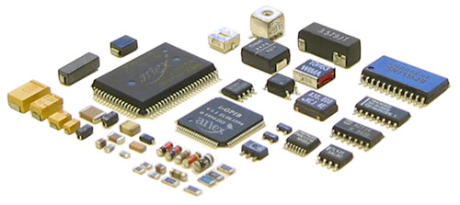
Electronic components & Electrical machines
Passive components R,L,C,XT etc.
Semiconductor devices
Diodes and LEDs
Transistors BJT and FET
Integrated circuits
Electrical machines
Motors - DC, Stepper
Solenoids

Slide 8
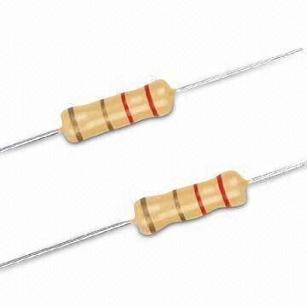
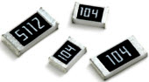
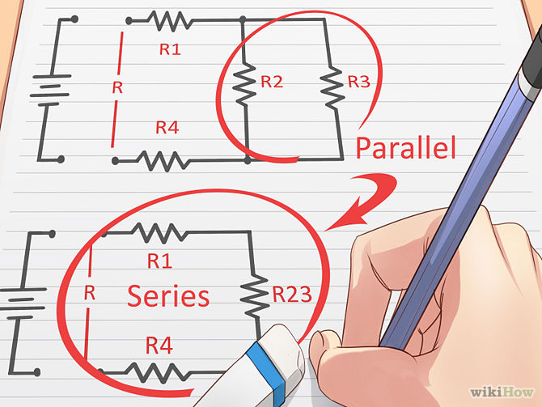
Electronic components & Electrical machines
Passive components – Resistors (R)
The unit for resistance is Ohm(Ω)
1MΩ=1000kΩ=1 000 000Ω
There’s nothing perfect – tolerances
Power rating (maximum dissipated power P)
Given: I=U/R and P=U.I,
we may derive the following
P=I.R.I= I².R
1W= 1V.1A → 1W= 1A.1Ω.1A
How do we calculate resistor circuits?
What do we need resistors for?
© Image courtesy of WikiHow

Slide 9
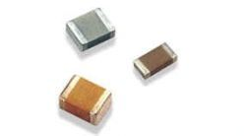
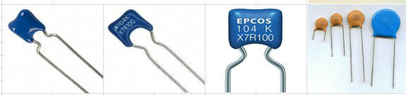
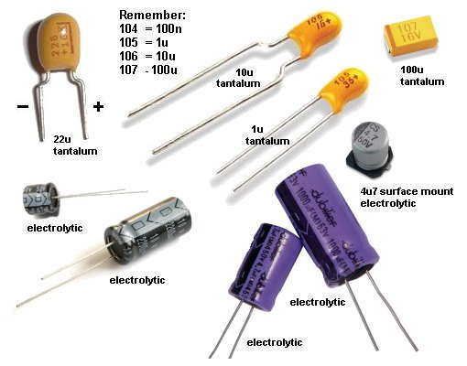
Electronic components & Electrical machines
Passive components – Capacitors (C)
The unit for Capacitance is Farad(F)
1µF=1000nF (not 1024;)) =1 000 000pF (micro, nano,pico)
What do we need capacitors for ???
Filtering
Store& release energy quickly when it’s needed
Capacitance:
Capacitance is the property of a part in an electric circuit, that opposes any
change of voltage. When the applied ac voltage increases, capacitance
opposes the change and delays the voltage increase across the circuit.
When the applied voltage decreases, capacitance tends to maintain
the original voltage across the circuit and delays the decrease in
voltage.

Slide 10
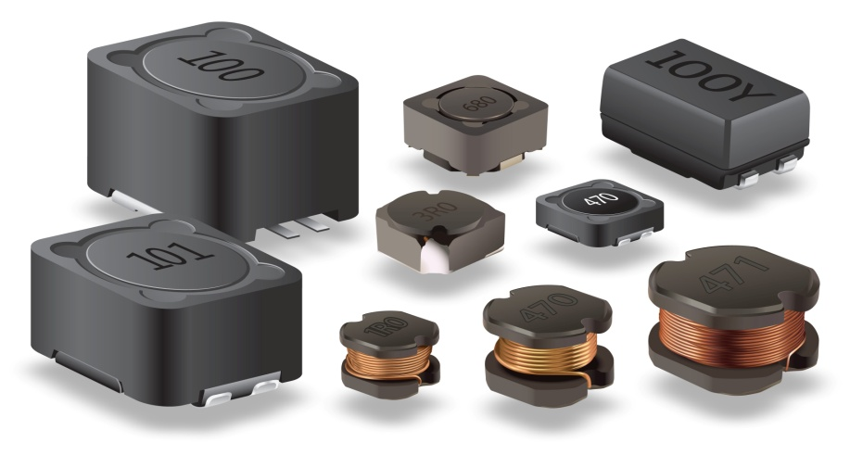
Electronic components & Electrical machines
Passive components - Inductors (L)
The unit for Inductance is Henry (H)
1H=1000nH =1 000 000 uH (micro, nano)
What do we need inductors for ???
Inductance:
When current flows through a conductor, a magnetic field is formed outside of the conductor.
The current direction determines the direction of the magnetic field.
Inductance is the property of an electric circuit by virtue of which a varying current induces an electromotive force in that circuit or in a neighboring circuit. We know from our previous discussion that magnetic lines of force surround the outside of a conductor when current flows. With an ac circuit, the voltage is constantly changing direction and the magnetic lines of force are constantly moving in and out from the conductor.
In any conductor, an expanding or collapsing magnetic field will cut across the conductor and induce
a voltage in the conductor that opposes the applied voltage.

Slide 11
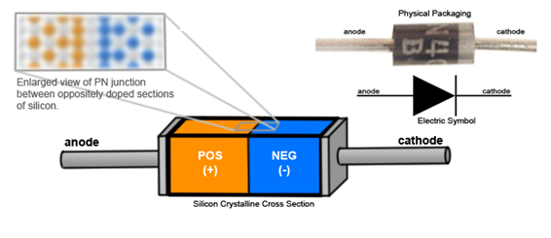
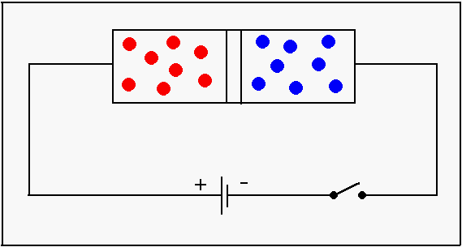
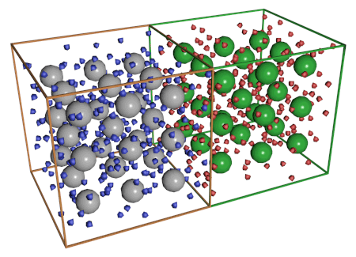
Electronic components & Electrical machines
Semiconductor devices
Diodes and LEDs
Diodes are semiconductor devices that have the property of letting current flow thru in only one direction.
They don’t conduct when connected in reverse direction (almost ☺).

Slide 12
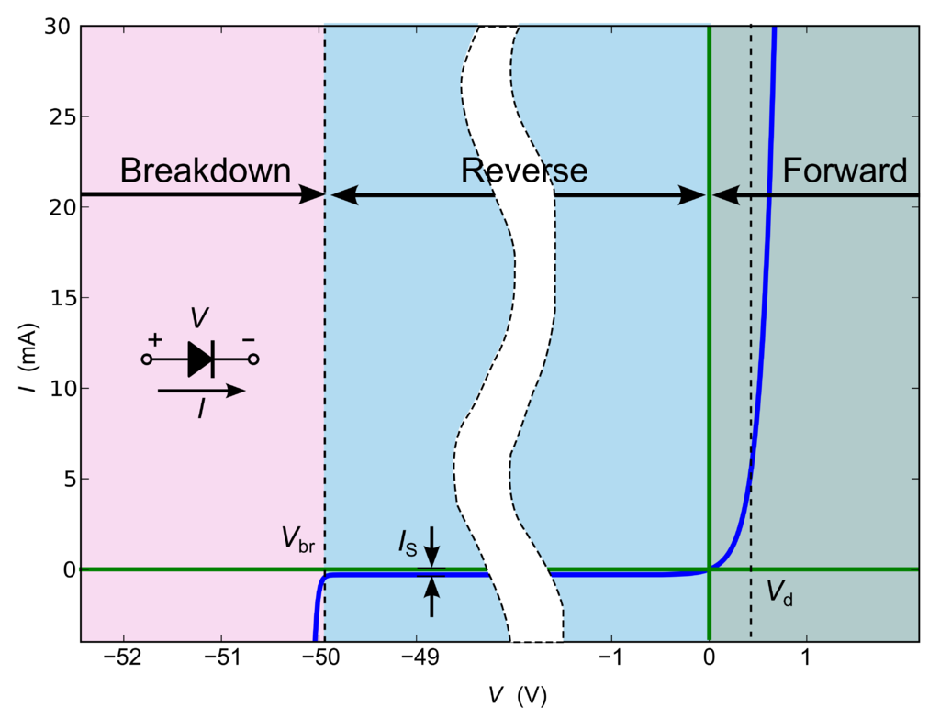
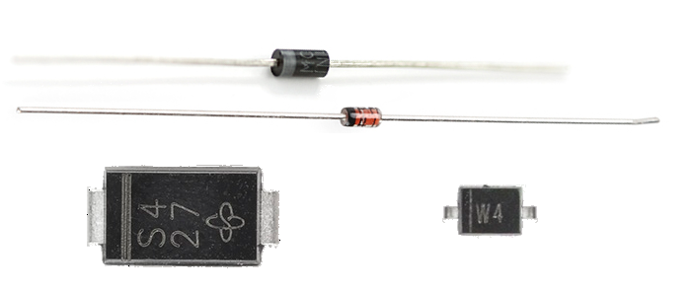
Electronic components & Electrical machines
Semiconductor devices
Diodes and LEDs – Some parameters
Vr max - allowed reverse (breakdown) voltage
If max – maximum current in forward direction
Power rating and packages

Slide 13
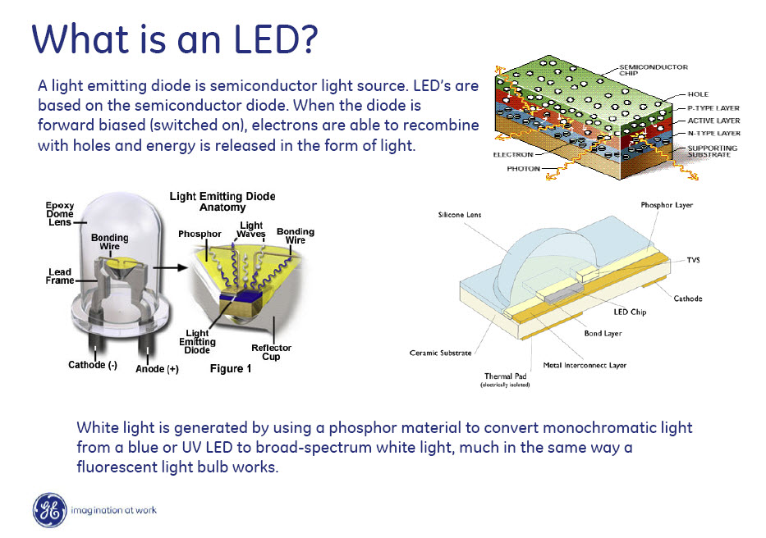
Electronic components & Electrical machines
Semiconductor devices
LEDs – LIGHT EMMITING DIODES

Slide 14
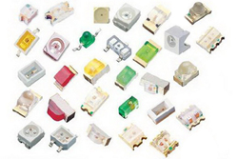
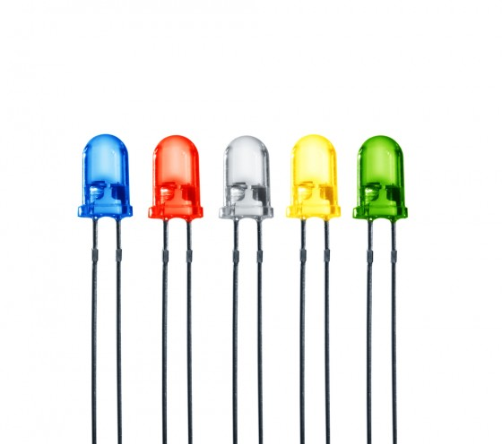
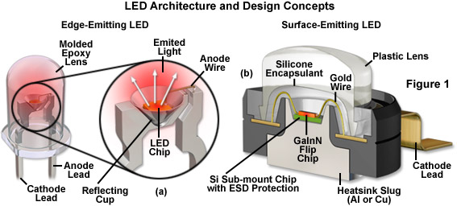
Electronic components & Electrical machines
LEDs – facts, types and parameters
LEDs come in a variety of colors
Different light colors (wavelengths) have different forward voltages

Slide 15
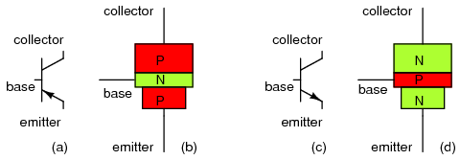
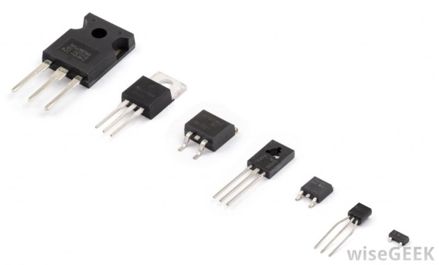
Electronic components & Electrical machines
Semiconductor devices
Transistors BJT
Transistors use three layers of silicon sandwiched instead of two. We can either make a p-n-p sandwich (with a slice of n-type silicon as the filling between two slices of p-type) or an n-p-n sandwich (with the p-type in between the two slabs of n-type).
If we join electrical contacts to all three layers of the sandwich, we can make a component that will either amplify a current or switch it on or off—in other words, a transistor. Let's see how it works in the case of an n-p-n transistor.
Let's give names to the three electrical contacts. We'll call the two contacts joined to the two pieces of n-type silicon the emitter and the collector, and the contact joined to the p-type silicon we'll call the base.
When no current is flowing in the transistor, we know the p-type silicon is short of electrons (shown here by the little plus signs, representing positive charges) and the two pieces of n-type silicon have extra electrons (shown by the little minus signs, representing negative charges).
☺ IN OTHER WORDS: We could say that while the n-type has a surplus of electrons, the p-type has holes where electrons should be. Normally, the holes in the base act like a barrier, preventing any significant current flow from the emitter to the collector while the transistor is in its "off" state.
A transistor works when the electrons and the holes start moving across the two junctions between the n-type and p-type silicon.
Let's connect the transistor up to some power. Suppose we attach a small positive voltage to the base, make the emitter negatively charged, and make the collector positively charged. Electrons are pulled from the emitter into the base—and then from the base into the collector. And the transistor switches to its "on" state:
Do you want to read more? :
http://hyperphysics.phy-astr.gsu.edu/hbase/solids/trans.html
http://www.talkingelectronics.com/projects/200TrCcts/200TrCcts.html
http://www.ibiblio.org/kuphaldt/electricCircuits/Semi/SEMI_2.html - CAUTION: MIGHT CAUSE BRAIN DAMAGE !!!
Notes:
TimeBound = 5 min

Slide 16
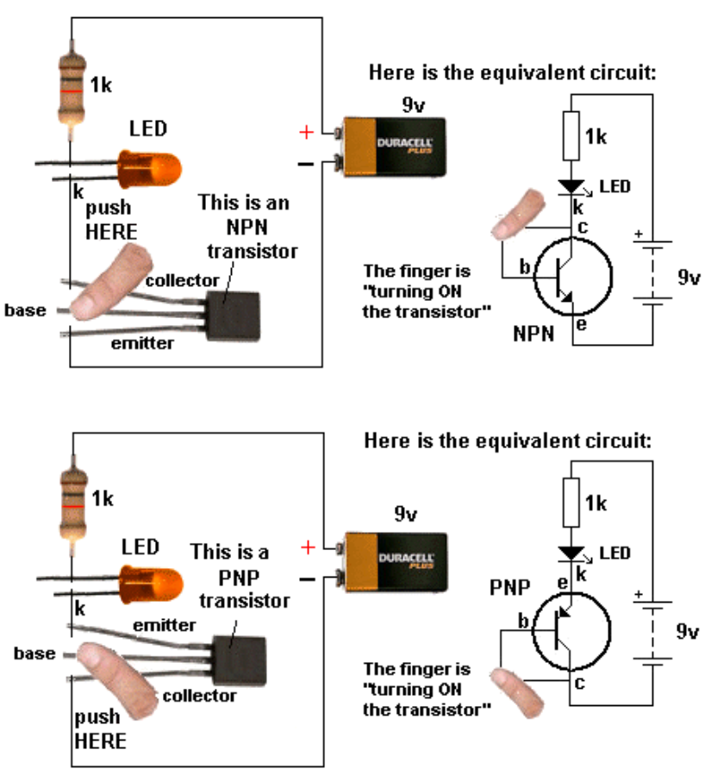
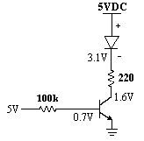
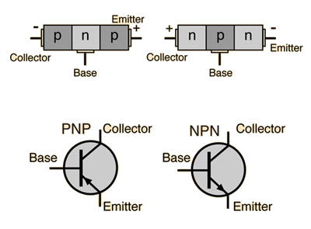
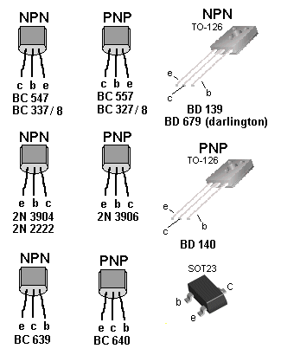
Electronic components & Electrical machines
Semiconductor devices
Transistors BJT
The transistor as a switch
Notes:
TimeBound = 5 min

Slide 17
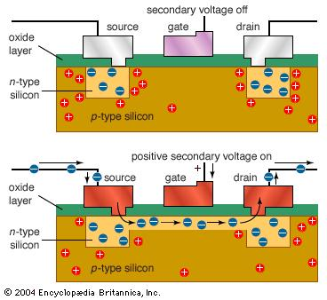
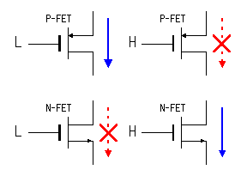
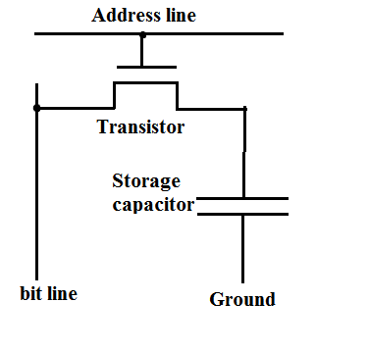
Electronic components & Electrical machines
Semiconductor devices
Field-effect transistor (FET)
How a field-effect transistor (FET) works
All transistors work by controlling the movement of electrons, but not all of them do it the same way. Like a junction transistor, a FET (field effect transistor) has three different terminals—but they have the names source (analogous to the emitter), drain (analogous to the collector), and gate (analogous to the base). In a FET, the layers of n-type and p-type silicon are arranged in a slightly different way and coated with layers of metal and oxide. That gives us a device called a MOSFET (Metal Oxide Semiconductor Field Effect Transistor).
Although there are extra electrons in the n-type source and drain, they cannot flow from one to the other because of the holes in the p-type gate in between them. However, if we attach a positive voltage to the gate, an electric field is created there that allows electrons to flow in a thin channel from the source to the drain. This "field effect" allows a current to flow and switches the transistor on:
For the sake of completeness, we could note that a MOSFET is a unipolar transistor because only one kind ("polarity") of electric charge is involved in making it work.

Slide 18
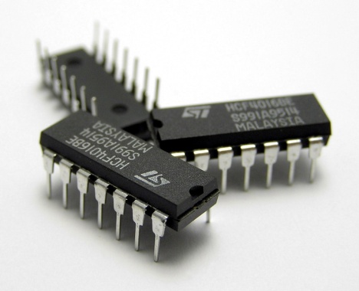
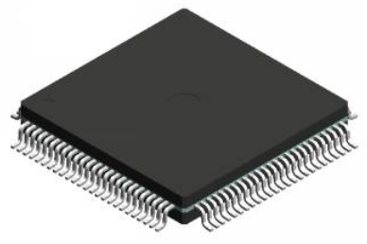
Electronic components & Electrical machines
Semiconductor devices
Integrated circuits
Purpose and application
Packages

Slide 19
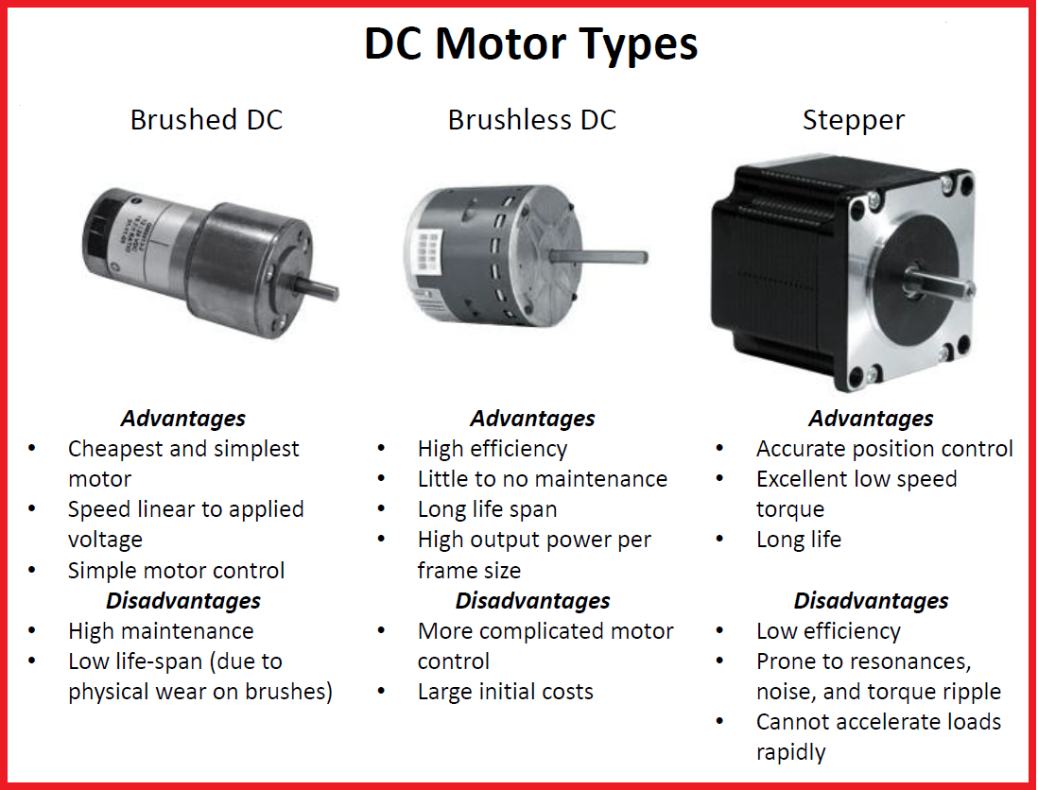
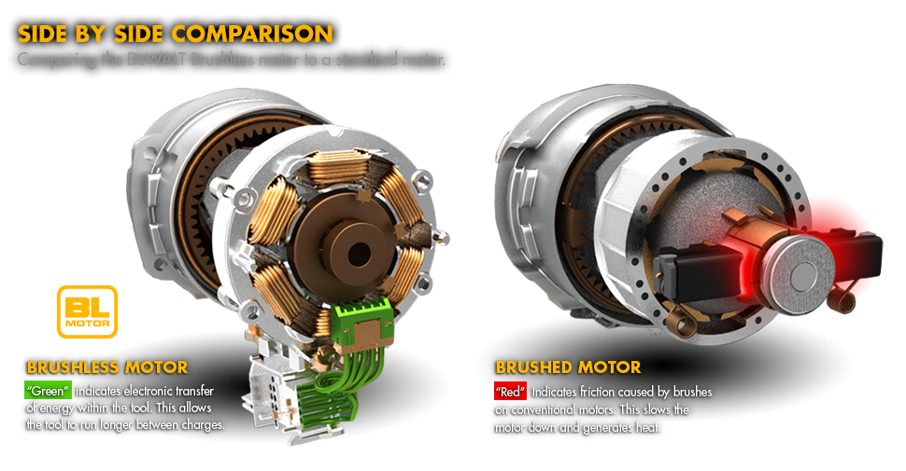
Electronic components & Electrical machines
Electrical machines
Motors - DC, Stepper, BLDC
http://www.nidec.com/en-NA/technology/capability/brushless/?prt=1
Notes:
TimeBound = 2 min

Slide 20
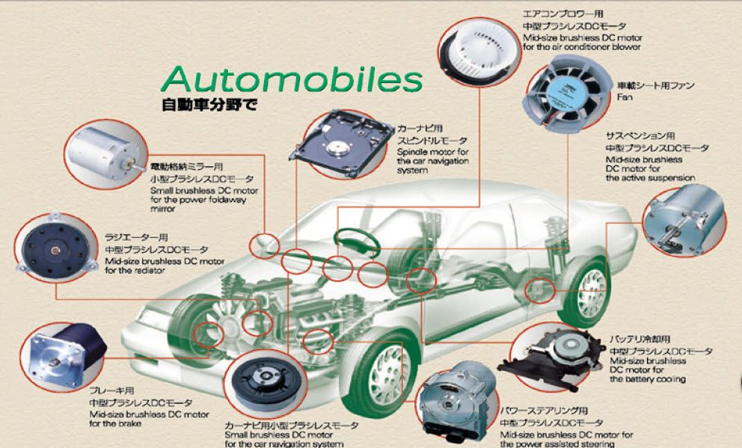
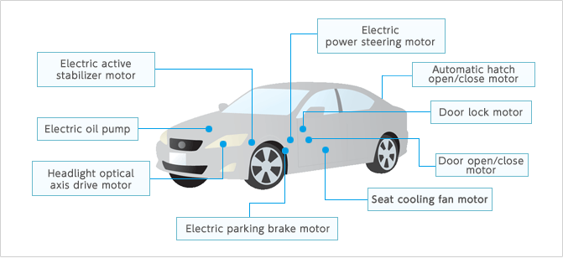
Electronic components & Electrical machines
Electrical machines
Motors - DC, Stepper, BLDC – automotive application
http://www.nidec.com/en-NA/technology/capability/brushless/?prt=1
Notes:
TimeBound = 3 min

Slide 21
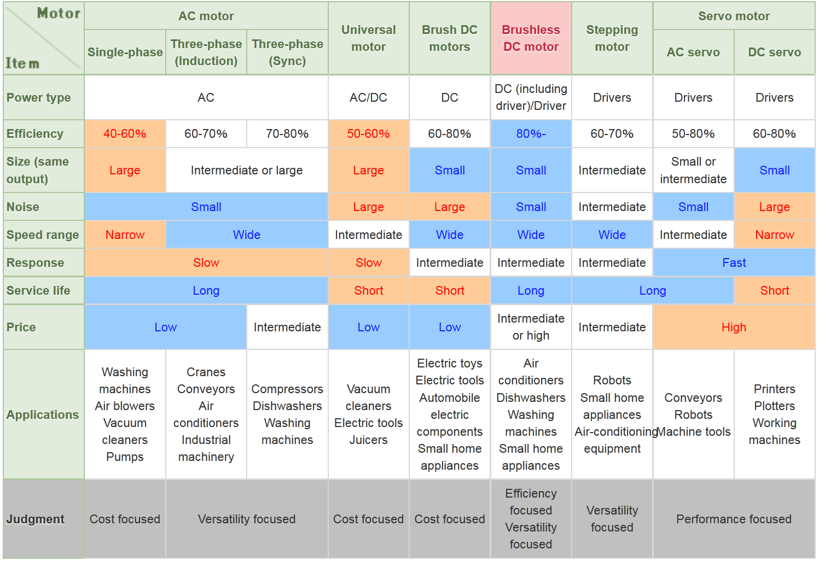
Electronic components & Electrical machines
Electrical machines
Motors - DC, Stepper, BLDC
http://www.nidec.com/en-NA/technology/capability/brushless/?prt=1

Slide 22
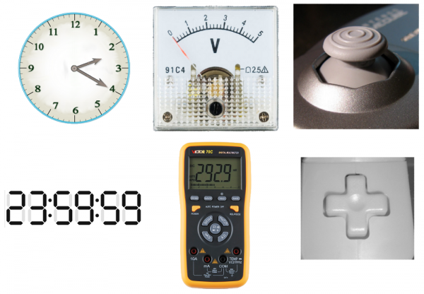
Electronic components & Electrical machines
Basic theory of signals
What is a signal?
Time-varying “quantities” which convey some sort of information.
Signals are passed between devices in order to send and receive information, which might be video, audio, or some sort of encoded data
Usually the signals are transmitted through wires, but they could also pass through the air via radio frequency (RF) waves.
Discrete and analog signals
Real-world objects can display data, gather inputs by either analog or digital means. (From left to right): Clocks, multimeters, and joysticks can all take either form (analog above, digital below).
http://library.automationdirect.com/understanding-discrete-analog-io/
Notes:
TimeBound = 30 min

Slide 23
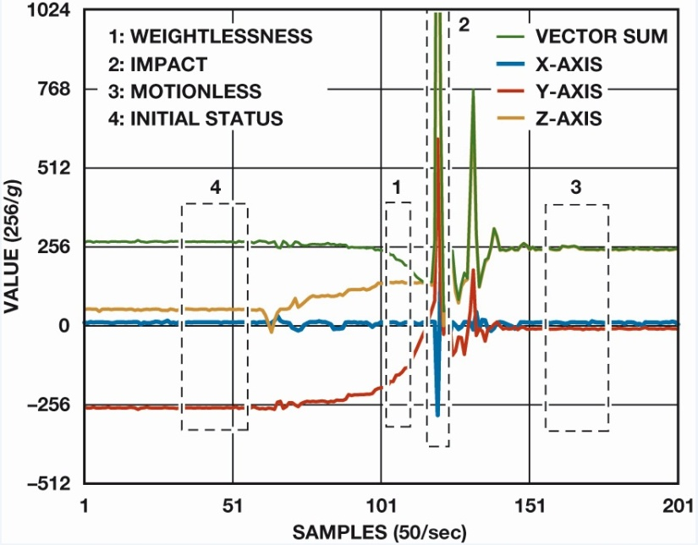
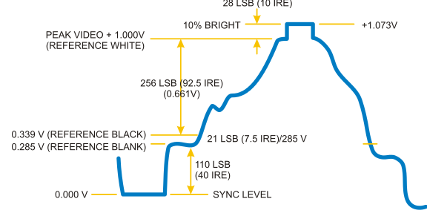
Electronic components & Electrical machines
Basic theory of signals
Analog Signals
While these signals may be limited to a range of maximum and minimum values, there are still an infinite number of possible values within that range.
An analog signal can be any time varying signal
They can be periodic or non-periodic
Audio signal from a music player output is a almost always aperiodic (non-periodic)
Sine waves are common periodic analog signal.
Video signal (1 line of a frame)
Three axis accelerometer output during a drop
https://learn.sparkfun.com/tutorials/analog-vs-digital
Notes:
TimeBound = 30 min

Slide 24
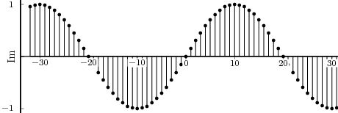
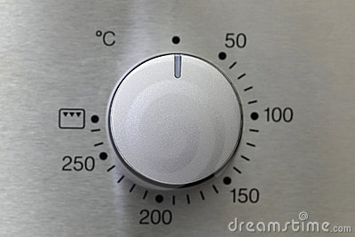
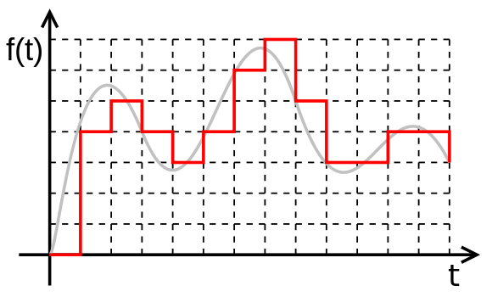
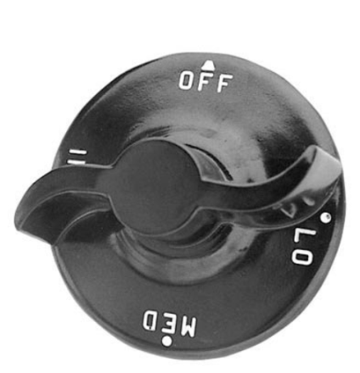
Electronic components & Electrical machines
Basic theory of signals
Discrete & digital signals
Digital signals are quantized, while analog signals are continuous.
Time discretization
https://learn.sparkfun.com/tutorials/analog-vs-digital
Notes:
TimeBound = 30 min

Slide 25
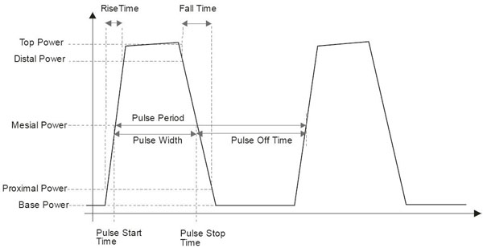
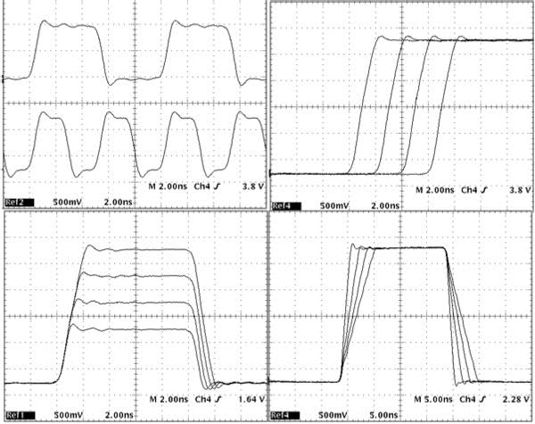
Electronic components & Electrical machines
Basic theory of signals
Pulsed signal parameters - timing and other features
Notes:
TimeBound = 30 min

Slide 26
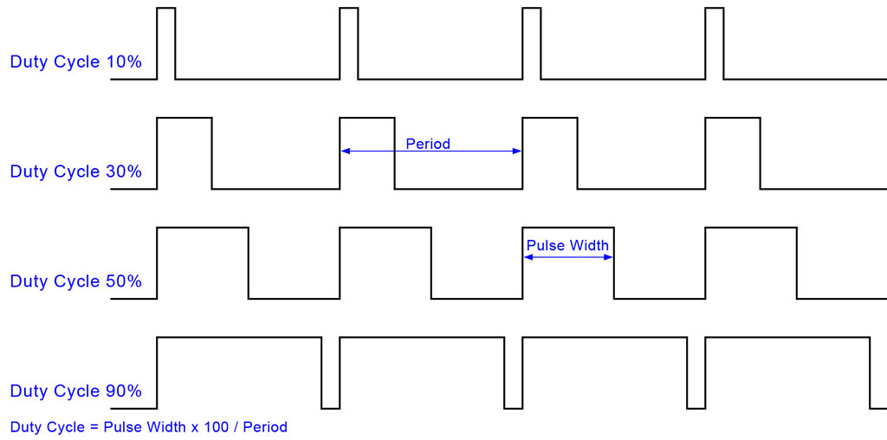
Electronic components & Electrical machines
Pulsed signal parameters – Pulse width modulation PWM
Notes:
TimeBound = 30 min

Slide 27
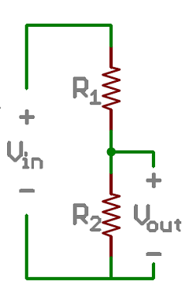

Electronic components & Electrical machines
Basic electrical circuits
Voltage divider
A voltage divider involves applying a voltage source across a series of two resistors.
The Equation
The voltage divider equation assumes that you know three values of the above circuit: the input voltage (V_{in}), and both resistor values (R₁ and R₂). Given those values, we can use this equation to find the output voltage (V_{out}).
Notes:
TimeBound = 30 min

Slide 28

Electronic components & Electrical machines
Basic electrical circuits
Pull-up Resistors
Pull-up resistors are very common when using microcontrollers (MCUs) or any digital logic device. This tutorial will explain when and where to use pull-up resistors, then we will do a simple calculation to show why pull-ups are important.
https://learn.sparkfun.com/tutorials/pull-up-resistors
Notes:
TimeBound = 30 min

Slide 29


Electronic components & Electrical machines
Basic electrical circuits
RC circuits
Circuit which contain… obviously a capacitors and resistors
Notes:
TimeBound = 30 min

Slide 30


Electronic components & Electrical machines
Basic electrical circuits
RC circuits
RC Time Constant, Tau
Where:
Vc is the voltage across the capacitor
Vs is the supply voltage
t is the elapsed time since the application of the supply voltage
RC is the time constant of the RC charging circuit
The RC Time Constant
All Electrical or Electronic circuits or systems suffer from some form of “time-delay” between its input and output, when a signal or voltage, either continuous, ( DC ) or alternating ( AC ) is firstly applied to it. This delay is generally known as the time delay or Time Constant of the circuit and it is the time response of the circuit when a step voltage or signal is firstly applied.
τ
The symbol for a time constant is the greek lower caps letter “TAU”
Notes:
TimeBound = 30 min

Slide 31
Electronic components & Electrical machines
Basic electrical circuits
RC circuits
RC Time Constant, Tau
Time Constant | RC Value | Percentage of Maximum
 |  | Voltage | Current
0.5 time constant | 0.5T = 0.5RC | 39.3% | 60.7%
0.7 time constant | 0.7T = 0.7RC | 50.3% | 49.7%
1.0 time constant | 1T = 1RC | 63.2% | 36.8%
2.0 time constants | 2T = 2RC | 86.5% | 13.5%
3.0 time constants | 3T = 3RC | 95.0% | 5.0%
4.0 time constants | 4T = 4RC | 98.2% | 1.8%
5.0 time constants | 5T = 5RC | 99.3% | 0.7%
Notes:
TimeBound = 30 min

Slide 32
Electronic components & Electrical machines
Basic electrical circuits
Digital circuits – inverter etc.
End of part one.
Notes:
TimeBound = 30 min

Slide 33

Microcontrollers and microprocessors
Part two
Microcontrollers, interfaces & peripherals
Definition, parameters, classification and structure
Functional blocks of a MCU. Internal structure, ports and types of ports
fuses and special registers
Interrupts
WDT, BOR, POR
Programming interfaces JTAG & ICSP
Timers and counters
Notes:
Definition – 5min
Registers – 15 min
Interupts – 10 min
WDG – 5min
Jtag – 5 min
Timers – 10 min
D/RAM – 5 min
Flash – 10 min
ROM – 5 min
EEPROM – 5 min
Power – 5 min
Oscilators – 10 min

Slide 34


Microcontrollers and microprocessors
Definition, parameters, classification and structure
Notes:
Definition – 5min
Registers – 15 min
Interupts – 10 min
WDG – 5min
Jtag – 5 min
Timers – 10 min
D/RAM – 5 min
Flash – 10 min
ROM – 5 min
EEPROM – 5 min
Power – 5 min
Oscilators – 10 min

Slide 35
Microcontrollers and microprocessors
Memory units
DRAM & ROM
Volatile and non-volatile memories
Notes:
Definition – 5min
Registers – 15 min
Interupts – 10 min
WDG – 5min
Jtag – 5 min
Timers – 10 min
D/RAM – 5 min
Flash – 10 min
ROM – 5 min
EEPROM – 5 min
Power – 5 min
Oscilators – 10 min

Slide 36
Microcontrollers and microprocessors
RAM
The RAM family includes two important memory devices: static RAM (SRAM) and dynamic RAM (DRAM). The primary difference between them is the lifetime of the data they store.
SRAM retains its contents as long as electrical power is applied to the chip. If the power is turned off or lost temporarily, its contents will be lost forever.
DRAM, on the other hand, has an extremely short data lifetime-typically about four milliseconds. This is true even when power is applied constantly. DRAM controller is used to refresh the data before it expires, the contents of memory can be kept alive for as long as they are needed. So DRAM is as useful as SRAM after all.
Notes:
Definition – 5min
Registers – 15 min
Interupts – 10 min
WDG – 5min
Jtag – 5 min
Timers – 10 min
D/RAM – 5 min
Flash – 10 min
ROM – 5 min
EEPROM – 5 min
Power – 5 min
Oscilators – 10 min

Slide 37
Microcontrollers and microprocessors
Types of RAM
Double Data Rate synchronous dynamic random access memory or also known as DDR1 SDRAM is a class of memory integrated circuits used in computers. The interface uses double pumping (transferring data on both the rising and falling edges of the clock signal) to lower the clock frequency. One advantage of keeping the clock frequency down is that it reduces the signal integrity requirements on the circuit board connecting the memory to the controller.
Notes:
Definition – 5min
Registers – 15 min
Interupts – 10 min
WDG – 5min
Jtag – 5 min
Timers – 10 min
D/RAM – 5 min
Flash – 10 min
ROM – 5 min
EEPROM – 5 min
Power – 5 min
Oscilators – 10 min

Slide 38
Microcontrollers and microprocessors
DDR2, DDR and SDRAM
DDR2 memory is fundamentally similar to DDR SDRAM. Still, while DDR SDRAM can transfer data across the bus two times per clock, DDR2 SDRAM can perform four transfers per clock. DDR2 uses the same memory cells, but doubles the bandwidth by using the multiplexing technique.
The DDR2 memory cell is still clocked at the same frequency as DDR SDRAM and SDRAM cells, but the frequency of the input/output buffers is higher with DDR2 SDRAM (as shown in Fig. on next Slide). The bus that connects the memory cells with the buffers is twice wider compared to DDR. Thus, the I/O buffers perform multiplexing: the data is coming in from the memory cells along a wide bus and is going out of the buffers on a bus of the same width as in DDR SDRAM, but of a twice bigger frequency. This allows to increase the memory bandwidth without increasing the operational frequency.
Notes:
Definition – 5min
Registers – 15 min
Interupts – 10 min
WDG – 5min
Jtag – 5 min
Timers – 10 min
D/RAM – 5 min
Flash – 10 min
ROM – 5 min
EEPROM – 5 min
Power – 5 min
Oscilators – 10 min

Slide 39

Microcontrollers and microprocessors
The interface uses double
pumping (transferring data
on both the rising and falling
edges of the clock signal to
lower the clock frequency.
One advantage of keeping the
clock frequency down is that it
reduces the signal integrity
requirements on the circuit
board connecting the memory
to the controller.
Notes:
Definition – 5min
Registers – 15 min
Interupts – 10 min
WDG – 5min
Jtag – 5 min
Timers – 10 min
D/RAM – 5 min
Flash – 10 min
ROM – 5 min
EEPROM – 5 min
Power – 5 min
Oscilators – 10 min

Slide 40
Microcontrollers and microprocessors
EEPROMS are electrically-erasable-and-programmable.
The erase operation is accomplished electrically, rather than by exposure to ultraviolet light.
Any byte within an EEPROM may be erased and rewritten.
Once written, the new data will remain in the device forever-or at least until it is electrically erased.
The primary tradeoff for this improved functionality is higher cost, though write cycles are also significantly longer than writes to a RAM. So you wouldn't want to use an EEPROM for your main system memory.
Notes:
Definition – 5min
Registers – 15 min
Interupts – 10 min
WDG – 5min
Jtag – 5 min
Timers – 10 min
D/RAM – 5 min
Flash – 10 min
ROM – 5 min
EEPROM – 5 min
Power – 5 min
Oscilators – 10 min

Slide 41

Microcontrollers and microprocessors
Flash – NAND & NOR
A typical flash memory comprises a memory array, which includes a large number of memory cells. Each of the memory cells includes a floating gate field-effect transistor capable of holding a charge.
The cells are usually grouped into sections called "erase blocks." Each of the cells within an erase block can be electrically programmed in a random basis by charging the floating gate. The charge can be removed from the floating gate by a block erase operation, where all floating gate memory cells in the erase block are erased in a single operation.
Notes:
Definition – 5min
Registers – 15 min
Interupts – 10 min
WDG – 5min
Jtag – 5 min
Timers – 10 min
D/RAM – 5 min
Flash – 10 min
ROM – 5 min
EEPROM – 5 min
Power – 5 min
Oscilators – 10 min

Slide 42
Microcontrollers and microprocessors
NOR vs. NAND Architectures
The memory cells of both an EEPROM (electrically erasable programmable read-only memory) memory array and a flash memory array are typically arranged into either a "NOR" or "NAND" architecture :
NOR architecture -- each cell directly coupled to a bit line, allows true random access.
NAND architecture -- cells coupled into "strings" of cells, such that each cell is coupled indirectly to a bit line and requires activating the other cells of the string for access.
Flash memory is a type of EEPROM, but the term EEPROM usually refers to non-flash EEPROM, where data can be erased in small units, usually bytes. Most solid-state drives, USB flash, and memory cards use NAND flash. Erasing, usually a slow process, is much faster in flash than non-flash EEPROM, because of the large block sizes used in flash.
Notes:
Definition – 5min
Registers – 15 min
Interupts – 10 min
WDG – 5min
Jtag – 5 min
Timers – 10 min
D/RAM – 5 min
Flash – 10 min
ROM – 5 min
EEPROM – 5 min
Power – 5 min
Oscilators – 10 min

Slide 43
Microcontrollers and microprocessors
Typical operating circuits.
Power supply domains.
Clock sources - Oscillators, frequency domains, PLLs and all that jazz☺
Clock Sources
The STM32 Reference Manual (RM0090) states that there are five clocks available:
High Speed Internal (HSI) oscillator
High Speed External (HSE) oscillator
Phase Locked Loop (PLL)
Low Speed Internal (LSI) clock
Low Speed External (LSE) clock
http://blog.mark-stevens.co.uk/2013/03/stm32f4-clocks/
Notes:
Definition – 5min
Registers – 15 min
Interupts – 10 min
WDG – 5min
Jtag – 5 min
Timers – 10 min
D/RAM – 5 min
Flash – 10 min
ROM – 5 min
EEPROM – 5 min
Power – 5 min
Oscilators – 10 min

Slide 44
Microcontrollers and microprocessors
Clock sources - Oscillators, frequency domains, PLLs and all that jazz☺
The first three clocks are used to drive the system clock for the microcontroller. The final two are low speed clocks and are primarily used to drive the watchdogs.
HSI
After reset, the STM32 enables the HSI oscillator. This has a relatively low accuracy, only 1%, but is suitable for most applications. Using the HSI oscillator eliminates the need for an external clock in the final circuit design. On the STM32F4, the HSI oscillator has a clock speed of 16 MHz.
HSE
The STM32 can operate using an external clock circuit. It is possible to design an external clock to run with a greater accuracy than the internal HSI clock enabling finer control of the operating parameters of the final circuit. The exact specification of the external clock frequency varies but is typically 4-16 MHz.
The STM32F4 Discovery Board has a built in external oscillator circuit fitted with a 8 MHz crystal.
PLL
The PLL is used to multiply it’s input clock source by a factor varying between 2 to 16. The input of the PLL is one of HSI, HSE or HSE/2.
It is important to note that the configuration of the PLL cannot be changed once it has been enabled.
LSI
The LSI is a low power clock used for the watchdog timers.
LSE
The LSE is powered by an external 32.768 KHz clock. This provides a method of providing a low speed accurate clock for the real time clock.
http://blog.mark-stevens.co.uk/2013/03/stm32f4-clocks/
Notes:
Definition – 5min
Registers – 15 min
Interupts – 10 min
WDG – 5min
Jtag – 5 min
Timers – 10 min
D/RAM – 5 min
Flash – 10 min
ROM – 5 min
EEPROM – 5 min
Power – 5 min
Oscilators – 10 min

Slide 45
Interfaces & Peripheral devices
Interfaces
Serial asynchronous - UART (TTL&RS232,RS485)
What is Serial?
The concept of serial communication is simple. The serial port sends and receives bytes of information one bit at a time. This is slower than parallel communication, which allows the transmission of an entire byte at once; however, it is simpler and can be used over longer distances. For example, the IEEE 488 specifications for parallel communication state that the cabling between equipment can be no more than 20 meters total, with no more than 2 meters between any two devices; serial can extend as much as 1200 meters. Typically, serial is used to transmit ASCII data. Communication is completed using 3 transmission lines: (1) Ground, (2) Transmit, and (3) Receive. Since serial is asynchronous, the port is able to transmit data on one line while receiving data on another. This is referred to as Full-Duplex transmission. Other lines are available for handshaking, but are not required. The important serial characteristics are baud rate, data bits, stop bits, and parity. For two ports to communicate, these parameters must match:
Baud rate is a speed measurement for communication. It indicates the number of bit transfers per second. For example, 300 baud is 300 bits per second. When we refer to a clock cycle, in the context of serial, we mean the baud rate. For example, if the protocol calls for a 4800 baud rate, then the clock is running at 4800Hz. This means that the serial port is sampling the data line at 4800Hz. Common baud rates for telephone lines are 14400, 28800, and 33600. Baud rates greater than these are possible, but these rates reduce the distance by which devices can be separated. These high baud rates are used for device communication where the devices are located near one another.
Data bits are a measurement of the actual data bits in a transmission. When the computer sends a packet of information, the amount of actual data may not be a full 8 bits. Standard values for the data packets are 5, 7, and 8 bits. Which setting you choose depends on what information you are transferring. For example, standard ASCII has values from 0 to 127 (7 bits). Extended ASCII uses 0 to 255 (8 bits). If the data being transferred is simple text (standard ASCII), then sending 7 bits of data per packet is sufficient for communication. A packet refers to a single byte transfer, including start/stop bits, data bits, and parity. Since the number of actual bits depend on the protocol selected, the term packet is used to cover all instances.
Stop bits are used to signal the end of communication for a single packet. Typical values are 1, 1.5, and 2 bits. Since the data is clocked across the lines and each device has its own clock, it is possible for the two devices to become slightly out of sync. Therefore, the stop bits not only indicate the end of transmission but also give the computers some room for error in the clock speeds. The more bits that are used for stop bits, the greater the lenience in synchronizing the different clocks, but the slower the data transmission rate.
Parity is a simple form of error checking that is used in serial communication. There are four types of parity: even, odd, marked, and spaced. The option of using no parity is also available. For even and odd parity, the serial port will set the parity bit (the last bit after the data bits) to a value to ensure that the transmission has an even or odd number of logic high bits. For example, if the data was 011, then for even parity, the parity bit would be 0 to keep the number of logic high bits even. If the parity was odd, then the parity bit would be 1, resulting in 3 logic high bits. Marked and spaced parity does not actually check the data bits, but simply sets the parity bit high for marked parity or low for spaced parity. This allows the receiving device to know the state of a bit which enables the device to determine if noise is corrupting the data or if the transmitting and receiving devices' clocks are out of sync.
Notes:
Async – 5 min
Sync – 5 min
Displ – 10 min
Cap + PWM – 10 min
ADC/DAC – 10 min
RTC – 5 min
Shift register – 5 min

Slide 46
Interfaces & Peripheral devices
Interfaces
Serial synchronous - SPI , I2C
Notes:
Async – 5 min
Sync – 5 min
Displ – 10 min
Cap + PWM – 10 min
ADC/DAC – 10 min
RTC – 5 min
Shift register – 5 min

Slide 47
Interfaces & Peripheral devices
Interfaces
Display types and interfaces - RGB parallel, LVDS, 8080, serial
Notes:
Async – 5 min
Sync – 5 min
Displ – 10 min
Cap + PWM – 10 min
ADC/DAC – 10 min
RTC – 5 min
Shift register – 5 min

Slide 48
Interfaces & Peripheral devices
Peripheral devices
Capture, Compare, PWM
Notes:
Async – 5 min
Sync – 5 min
Displ – 10 min
Cap + PWM – 10 min
ADC/DAC – 10 min
RTC – 5 min
Shift register – 5 min

Slide 49


Interfaces & Peripheral devices
Peripheral devices
ADC/DAC
What is a sample?
The sample rate is the number of times an analog signal is measured or sampled per second.
You can also think of the sample rate as the number of electronic snapshots made of the signal form per second.
Unlike analog signals, which have an infinite range of volume levels, digital signal samples use binary numbers (bits) to represent the level of each audio sample. The accuracy of each sample is determined by the resolution in bits. Higher bit depths mean your signal is more accurately represented when it is sampled.
Notes:
Async – 5 min
Sync – 5 min
Displ – 10 min
Cap + PWM – 10 min
ADC/DAC – 10 min
RTC – 5 min
Shift register – 5 min

Slide 50
Interfaces & Peripheral devices
Peripheral devices
RTC - real time clocks
Notes:
Async – 5 min
Sync – 5 min
Displ – 10 min
Cap + PWM – 10 min
ADC/DAC – 10 min
RTC – 5 min
Shift register – 5 min

Slide 51
Interfaces & Peripheral devices
Peripheral devices
Shift register
Notes:
Async – 5 min
Sync – 5 min
Displ – 10 min
Cap + PWM – 10 min
ADC/DAC – 10 min
RTC – 5 min
Shift register – 5 min

Slide 52
Practical Exercises
End of part two.

Slide 53
Practical Exercises
Part three
Using electronics workbench tools
Basic electrical safety - introduction.
Benchtop power supply.
Measurement of voltage & current.
Using an oscilloscope?
Using a functional generator?
Soldering.
Circuit exercises
Simple LED circuit, LED biasing.
Button circuit - digital input handling.
Measurement of temperature - analog sampling
Driving an automotive speed pointer - driving a bipolar stepper motor.
Inverted pendulum

Slide 54


Practical Exercises
Using electronics workbench tools – Power supply
What it does ?
Serves as a power source for your devices.
Provides regulated voltage/current
What you should we know about it?
Maximum operating limits
Maximum voltage
Maximum current
Maximum power
Number of channels
How do we use it?
Set the output Voltage/Current
Connect to power input of the device.
Observe polarity or you’ll see the blue smoke☺!!!
Notes:
10 min

Slide 55


Practical Exercises
Using electronics workbench tools – digital multimeter
Notes:
10 min

Slide 56


Practical Exercises
Using electronics workbench tools - functional generator
Notes:
5 min

Slide 57

Practical Exercises
Using electronics workbench tools - oscilloscope
Notes:
15 min

Slide 58

www.visteon.com

